Slide 1
Week 3
Accessing Data

Slide 2
Week 3 Agenda
Lecture
SQL
Filtering Data Queries with Logical Operators
Lab 3 (5%)

Slide 3
SQL Keywords
LIMIT / OFFSET :
AND :
OR :
NOT :
LIKE :
BETWEEN :
IN :
ORDER BY :
IS NULL :
SELECT * FROM movie LIMIT 5 OFFSET 7;
SELECT * FROM movie WHERE genre='Drama' AND release_year>2020;
SELECT * FROM movie WHERE genre='Drama' OR genre='Comedy';
SELECT * FROM movie WHERE NOT genre='Animation';
SELECT * FROM movie WHERE title LIKE 'The%';
SELECT * FROM movie WHERE title BETWEEN 'A' AND 'J';
SELECT * FROM movie WHERE genre IN ('Comedy', 'Drama', 'Romance');
SELECT * FROM movie ORDER BY title;
SELECT * FROM movie WHERE release_year IS NULL;

Slide 4
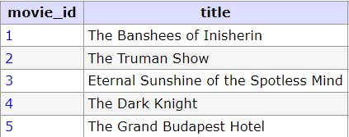
LIMIT¹
LIMIT is used to specify the number of records to return
Example: Return the first 5 movies in the table
SELECT * FROM movie LIMIT 5;
Syntax
SELECT column_1, column_2, ...
FROM table_name
LIMIT <limitNum>;
¹ https://www.w3schools.com/sql/sql_ref_limit.asp

Slide 5
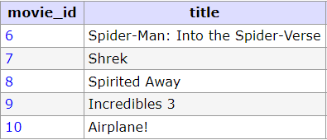
OFFSET¹
OFFSET is used to skip the number of rows specified
Example: Return the 6th to 10th movies in the table
SELECT * FROM movie
LIMIT 5 OFFSET 5;
OFFSET must be used with LIMIT
Syntax
SELECT column_1, ...
FROM table_name
LIMIT <limitNum>
OFFSET <offsetNum>;
SELECT column_1, ...
FROM table_name
LIMIT <offsetNum>,<limitNum>;
¹ https://www.guru99.com/limit.html

Slide 6
Logical Operators¹
Logical operators are used to refine SQL queries even more
These operators allow multiple comparisons to be made in 1 query
Example: Select all Drama or Comedy films
Without Logical Operator
With Logical Operator
SELECT * FROM movie WHERE genre='Drama';
SELECT * FROM movie WHERE genre='Comedy';
SELECT * FROM movie WHERE genre='Drama' OR genre='Comedy';
¹ https://www.w3schools.com/sql/sql_operators.asp#:~:text=SQL%20Logical%20Operators

Slide 7
Logical Operators¹
Logical operators are used to refine SQL queries even more
These operators allow multiple comparisons to be made in 1 query
Example: Select all Animation films under 100 minutes
Without Logical Operator
With Logical Operator
SELECT * FROM movie WHERE genre='Animation';
SELECT * FROM movie WHERE runtime<100;
SELECT * FROM movie WHERE genre='Animation' AND runtime<100;
¹ https://www.w3schools.com/sql/sql_operators.asp#:~:text=SQL%20Logical%20Operators

Slide 8
Logical Operators¹
AND
OR
IN
LIKE
BETWEEN
NOT
TRUE if all the conditions separated by AND is TRUE
eg. WHERE genre='Animation' AND runtime<100;
TRUE if any of the conditions separated by OR is TRUE
eg. WHERE genre='Animation' OR runtime<100;
TRUE if the operand is equal to one of a list of expressions
eg. WHERE genre IN ('Drama','Romance','Comedy');
TRUE if the operand matches a pattern
eg. WHERE title LIKE 'The%';
TRUE if the operand is within the range of comparisons
eg. WHERE runtime BETWEEN 60 AND 110;
Displays a record if the condition(s) is NOT TRUE
eg. WHERE column_name NOT <SomeComparison(s)>;
¹ https://www.w3schools.com/sql/sql_operators.asp#:~:text=SQL%20Logical%20Operators

Slide 9

AND¹
AND operator is used to filter records based on more than 1 condition
Example: Return all Drama movies released after 2020
SELECT * FROM movie
WHERE genre='Drama' AND release_year>2020;
Syntax
SELECT column_1, column_2, ...
FROM table_name
WHERE <condition_1> AND <condition_2> AND ...;
¹ https://www.w3schools.com/sql/sql_and.asp

Slide 10
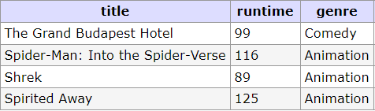
OR¹
OR operator is used to filter records based on more than 1 condition
Example: Return all Animation movies, but also comedy movies
SELECT * FROM movie
WHERE genre='Animation'
OR genre='Comedy';
Syntax
SELECT column_1, column_2, ...
FROM table_name
WHERE <condition_1> OR <condition_2> OR ...;
¹ https://www.w3schools.com/sql/sql_or.asp

Slide 11
NOT¹
NOT will give the opposite(or negative) result of the comparison it acts on
NOT can be used to exclude rows
Example:
SELECT * FROM movie WHERE genre<>'Animation';
Is the same as
SELECT * FROM movie WHERE NOT genre='Animation';
SELECT * FROM movie
WHERE NOT (genre='Animation' OR genre='Comedy');
¹ https://www.w3schools.com/sql/sql_not.asp

Slide 12
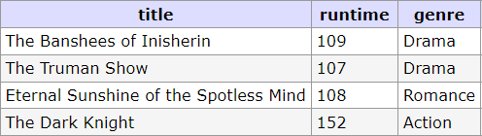
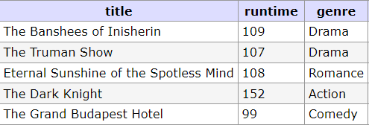
OR NOT
NOT with OR used to with exclude rows based on more than 1 condition
Using NOT to get the opposite: Return all movies that are NOT Animation or Comedy
SELECT * FROM movie
WHERE NOT (genre='Animation'
OR genre='Comedy');
NOT will be applied to all statements inside the brackets
Without brackets the NOT is only applied to the first comparison
SELECT * FROM movie
WHERE NOT genre='Animation'
OR genre='Comedy';
¹ https://www.w3schools.com/sql/sql_or.asp

Slide 13

AND NOT
NOT can be used without brackets to apply to only the first condition
Return all movies that are were released before 2005, but not animation films
SELECT * FROM movie
WHERE release_year<2005 AND NOT genre='Animation' ;
¹ https://www.w3schools.com/sql/sql_and.asp

Slide 14
Multiple AND/OR
Queries can contain one or many AND/OR operators
Queries can chain together to check multiple conditions
Example: Return all Animation movies released in 2001 and a runtime over 100 minutes
SELECT * FROM movie
WHERE genre='Animation' AND release_year=2001 AND runtime>100;
Example: Return all Action movies, movies released before 2000, also movies with runtime under 100
SELECT * FROM movie
WHERE genre='Action' OR release_year<2000 OR runtime<100;
Example: Return all Drama movies, Action movies, released before 2010
SELECT * FROM movie
WHERE (genre='Drama' OR genre='Action') AND release_year<2010;

Slide 15
Logical Operators / Truth Tables
NOT
AND
OR
P | NOT P
true | false
false | true
P | Q | P AND Q
true | true | trtrue
true | false | false
false | true | false
false | false | false
P | Q | P OR Q
true | true | trtrue
true | false | true
false | true | true
false | false | false

Slide 16
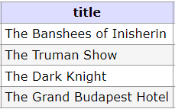
LIKE¹
LIKE operator is used to search for a specified pattern in a column
Example: Return all movies that begin with the word ‘The’
SELECT * FROM movie
WHERE title LIKE 'The%';
There are two wildcards used in conjunction with the LIKE operator
The percent sign % represents zero, one, or multiple of any characters
The underscore sign _ represents any one, single character
Syntax
SELECT column_1, column_2, ... FROM table_name
WHERE column_1 LIKE 'Som_ Text%';
¹ https://www.w3schools.com/sql/sql_like.asp

Slide 17

BETWEEN¹
BETWEEN selects values (numbers, text, or dates) within a given range
Example: Return all movies from A to J
SELECT * FROM movie
WHERE title BETWEEN 'A' AND 'J';
Inclusive: begin and end values are included
Syntax
SELECT column_1, column_2, ... FROM table_name
WHERE column_1 BETWEEN <start_value> AND <end_value>;
¹ https://www.w3schools.com/sql/sql_between.asp

Slide 18
IN¹
IN operator allows you to specify multiple values in a WHERE clause
Example: Return all Comedy, Drama, Romance movies
SELECT * FROM movie
WHERE genre IN ('Comedy', 'Drama', 'Romance');
IN operator is a shorthand for multiple OR conditions
Values may be numbers, text, or dates
Syntax
SELECT column_1, column_2, ... FROM table_name
WHERE column_1 IN (<value_1>, <value_2>, ...);
¹ https://www.w3schools.com/sql/sql_in.asp

Slide 19
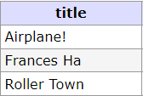
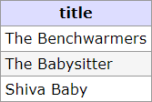
ORDER BY¹
ORDER BY is used to sort the output in ascending or descending order
Example sort all the movies in the table alphabetically
SELECT * FROM movie
ORDER BY title;
To reverse the order we add the keyword DESC
SELECT * FROM movie
ORDER BY title DESC;
¹ https://www.w3schools.com/sql/sql_orderby.asp

Slide 20
ORDER BY¹
ORDER BY can also sort by multiple columns
Example sort all the movie by runtime and then alphabetically
SELECT * FROM movie ORDER BY runtime, title;
By using ASC and DESC the order for each column can be set
SELECT * FROM movie ORDER BY runtime ASC, title DESC;
Syntax
SELECT column_1, column_2, ... FROM table_name
ORDER BY column_1, column_2, ... ASC|DESC;
¹ https://www.w3schools.com/sql/sql_orderby.asp

Slide 21
NULL¹
An empty field in a table row will be filled with the NULL value
NULL tells us there is an absence of data, the data does not exist
It is not possible to test for NULL values with comparison operators (=, <, <>)
We will have to use the IS NULL and IS NOT NULL operators instead
Example: Find all movies without a release year set
Example: Find all movies with a valid runtime
SELECT * FROM movie
WHERE ??? ;
¹ https://www.w3schools.com/sql/sql_null_values.asp

Slide 22
IS NULL¹
IS NULL operator is used to test for empty values (NULL values)
Example: Find all movies without a release year set
SELECT * FROM movie
WHERE release_year IS NULL;
Syntax
SELECT column_1, column_2, ... FROM table_name
WHERE column_1 IS NULL;
*Always use IS NULL to look for NULL values since NULL is not compatible with normal comparison operators
¹ https://www.w3schools.com/sql/sql_null_values.asp

Slide 23
IS NOT NULL¹
IS NOT NULL is used to test for non-empty values (NOT NULL values)
Example: Find all movies with a valid runtime
SELECT * FROM movie
WHERE runtime IS NOT NULL;
Syntax
SELECT column_1, column_2, ... FROM table_name
WHERE column_1 IS NOT NULL;
¹ https://www.w3schools.com/sql/sql_null_values.asp

Slide 24
SELECT Syntax
SELECT column_1, column_2, ...
FROM table_name
WHERE condition(s)
ORDER BY column ASC|DESC
LIMIT num_limit
OFFSET num_offset;

Slide 25
Next (Week 4)
Quiz (3%)
Lesson - Aggregate Functions
Lab 4 (6%)

Slide 26
W3 Summary
Terminology
Logical Operators: Programming-language symbols that denote logical operations
In SQL - AND, OR, NOT, LIKE, BETWEEN, IN
NULL - The value to represent the absence of a value

Slide 27
W3 Summary
SQL Keywords
LIMIT / OFFSET :
AND :
OR :
NOT :
LIKE :
BETWEEN :
IN :
ORDER BY :
IS NULL :
SELECT * FROM movie LIMIT 5 OFFSET 7;
SELECT * FROM movie WHERE genre='Drama' AND release_year>2020;
SELECT * FROM movie WHERE genre='Drama' OR genre='Comedy';
SELECT * FROM movie WHERE NOT genre='Animation';
SELECT * FROM movie WHERE title LIKE 'The%';
SELECT * FROM movie WHERE title BETWEEN 'A' AND 'J';
SELECT * FROM movie WHERE genre IN ('Comedy', 'Drama', 'Romance');
SELECT * FROM movie ORDER BY title;
SELECT * FROM movie WHERE release_year IS NULL;

Slide 28
Practice
W3Schools SQL
AND, OR, NOT, LIKE, BETWEEN, IN, ORDER BY, IS NULL, IS NOT NULL, LIMIT
SQL BOLT
SQL Lesson 2: Queries with constraints (Pt. 1)
SQL Lesson 3: Queries with constraints (Pt. 2)
SQL Lesson 4: Filtering and sorting Query results
SQL Review: Simple SELECT Queries

